Slide 1
Social Media Analytics
Topic 5: Social media monitoring tools

Slide 2
Learning Objectives
Social media monitoring tools
Different purposes of monitoring tools

Slide 3
Social media monitoring tools

Slide 4

How to find the right monitoring tool?

Slide 5

Find the right tool – Step 1
Understand the objective
How you look at the tool depends on your objectives. If you are interested in brand reputation and customer service, for example, you’ll be interested in tool that combines monitoring with engagement capabilities. – Stephen Rappaport, author of Listen First
Source: CRM Magazine

Slide 6
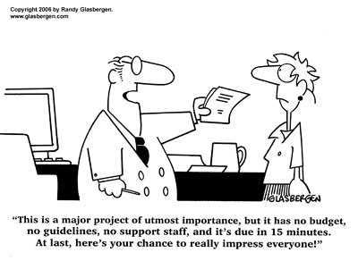
Find the right tool – Step 2
Determine the implementation strategy
Self-service product, product implemented by consultants or job implemented by outsourced team
These are just tools at the end of the day.. What I’ve seen happen at many companies is that they found the budget and are ready to select the vendor, but they don’t actually have people with enough time or training to use it. – Zach HoferShall of Forrester Research
Source: CRM Magazine

Slide 7
Find the right tool – Step 3
Review product features
Social media monitoring tool
Platforms for scanning social media networks and websites for key words and phrases that are relevant to the organization. – How to measure social media, Nichole Kelly
Social media engagement tool
Platforms for publishing and replying to status updates within the interface. They also may include workflow tools, like the ability to assign posts to other users for reply. – How to measure social media, Nichole Kelly
A service which lets a social media manager creates messages and conveniently cross-post to multiple social media channels, as well as reach out to customers directly – Jake Wengroff of Frost & Sullivan
Source: CRM Magazine

Slide 8
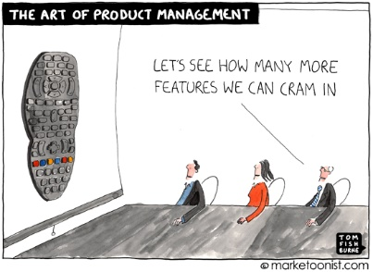
Find the right tool – Step 3 (cont.)
Review product features
Be aware of the difference between social media monitoring and social media engagement tools.
More vendors are combining the 2 services and both products “do monitoring”.
Social media engagement tools only measure the performance (clickthroughs, shares, etc.) of contents you created and not all content on the social web that references your brand. – Jake Wengroff of Frost & Sullivan
Source: CRM Magazine

Slide 9

Find the right tool – Step 4
Ability to archive historical results
Some platforms may store results for 2 years or even shorter time frame.
Importance for on-going campaigns monitoring
Compare the results with past campaigns
Source: CRM Magazine

Slide 10

Find the right tool – Step 5
Choose a product with flexible enterprise price plan
You may be the only one inside your company measuring the social media conversions, but little by little, more and more people may need access – Jake Wengroff of Frost & Sullivan
Select a solution with pricing that coincides with seat licenses or access level that you need – Jake Wengroff of Frost & Sullivan
Source: CRM Magazine

Slide 11
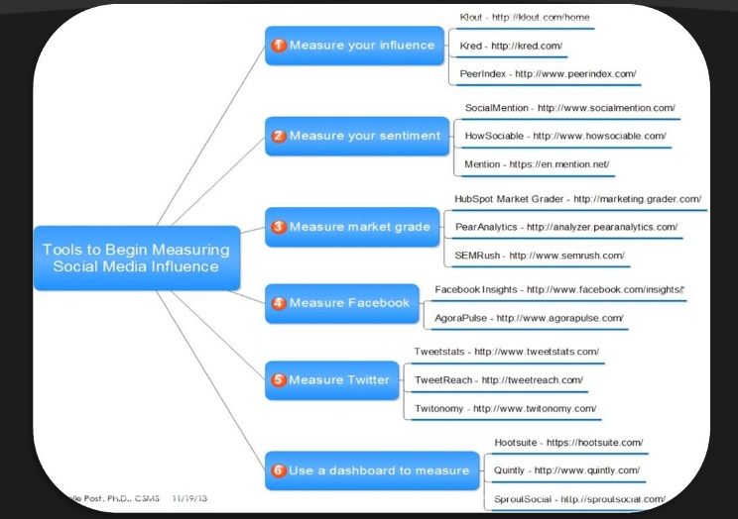
Tools for social media

